Slide 1
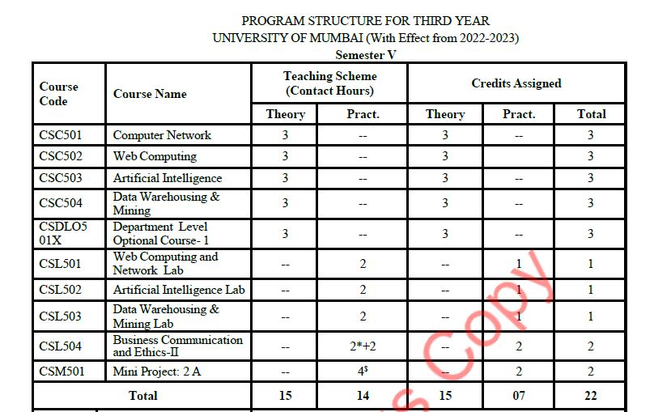

Slide 2
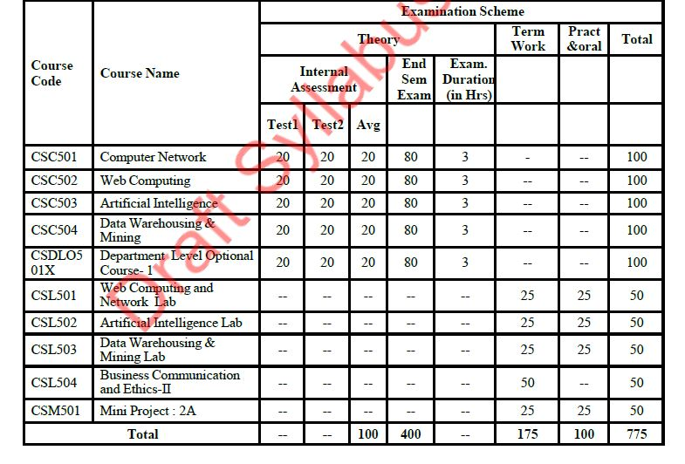

Slide 3
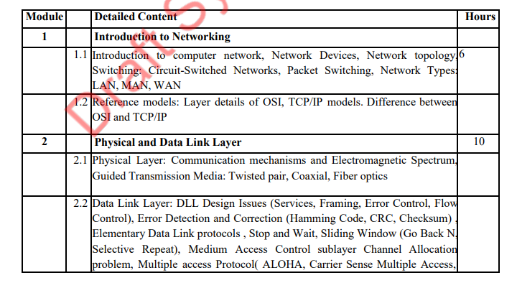

Slide 4
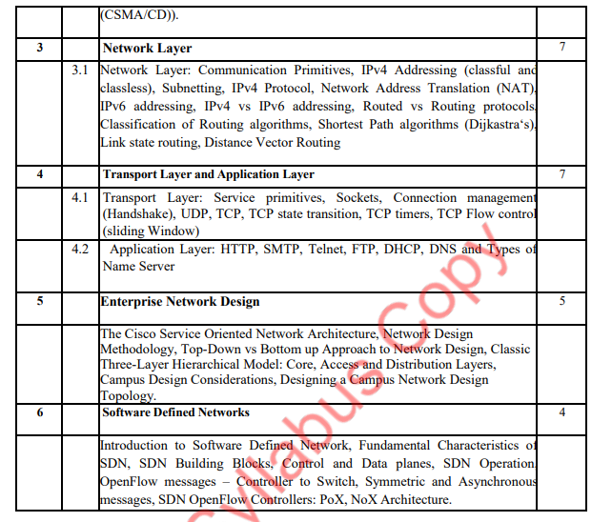

Slide 5
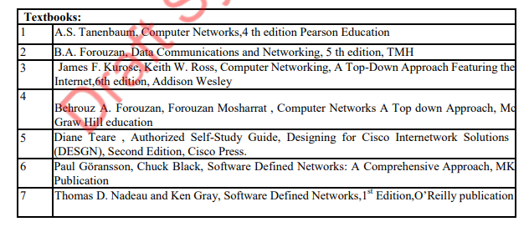

Slide 6
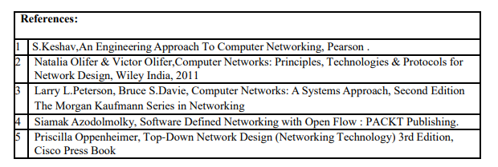

Slide 7
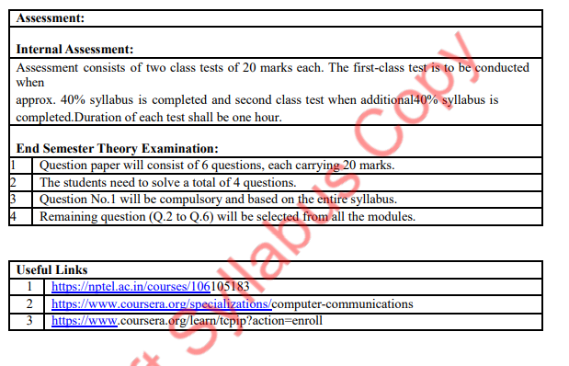

Slide 8
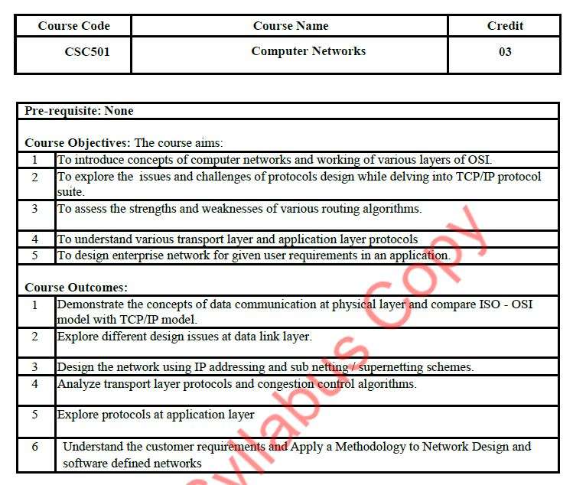

Slide 9
Module No | Name of Module | Hour | Marks
1. | Introduction to Networking | 6 | 18
2. | Physical and Data Link Layer | 10 | 32
3. | Network Layer | 7 | 21
4. | Transport Layer and Application Layer | 7 | 21
5. | Enterprise Network Design | 5 | 16
6. | Software Defined Networks | 4 | 12

Slide 10
Module 1
Introduction to Networking
1.1 Introduction to computer network, Network Devices, Network topology, Switching: Circuit-Switched Networks, Packet Switching, Network Types: LAN, MAN, WAN
1.2 Reference models: Layer details of OSI, TCP/IP models. Difference between OSI and TCP/IP

Slide 11
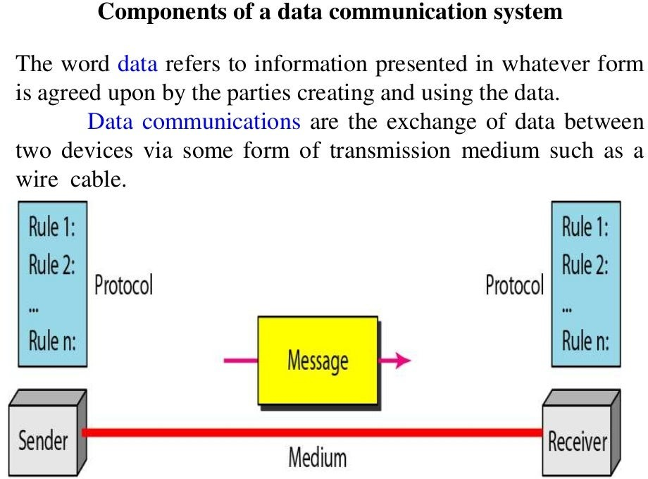

Slide 12
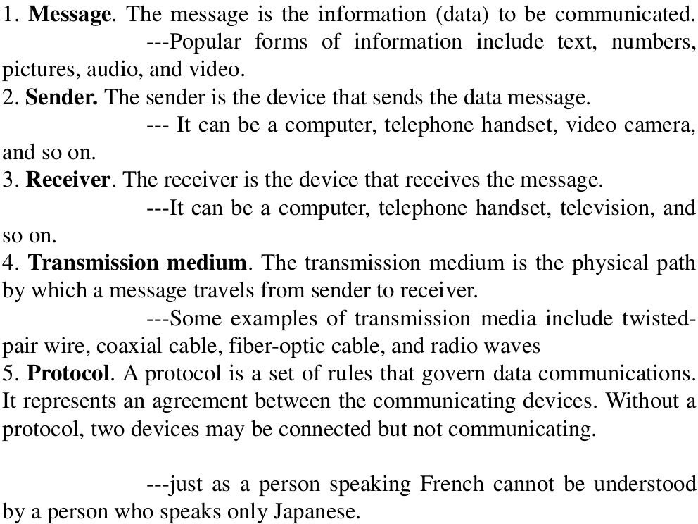

Slide 13
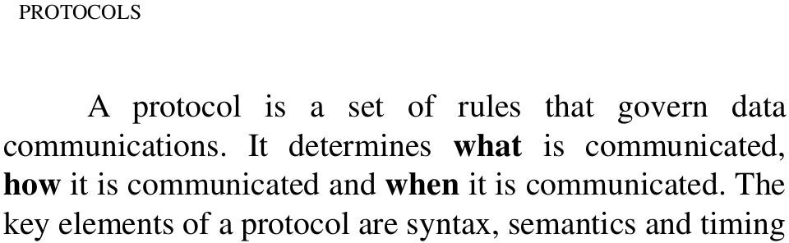

Slide 14
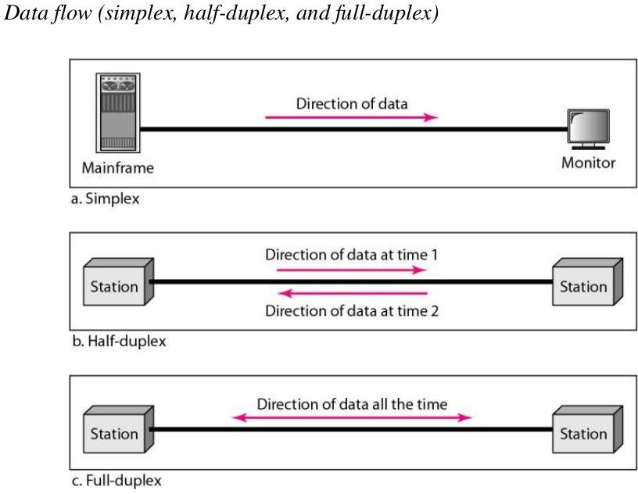

Slide 15
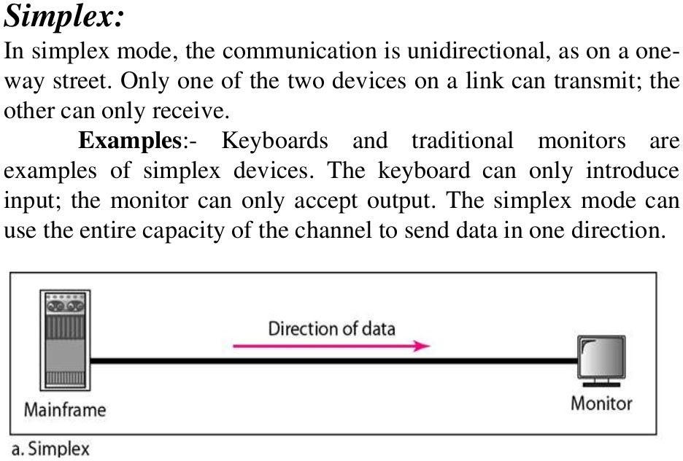

Slide 16
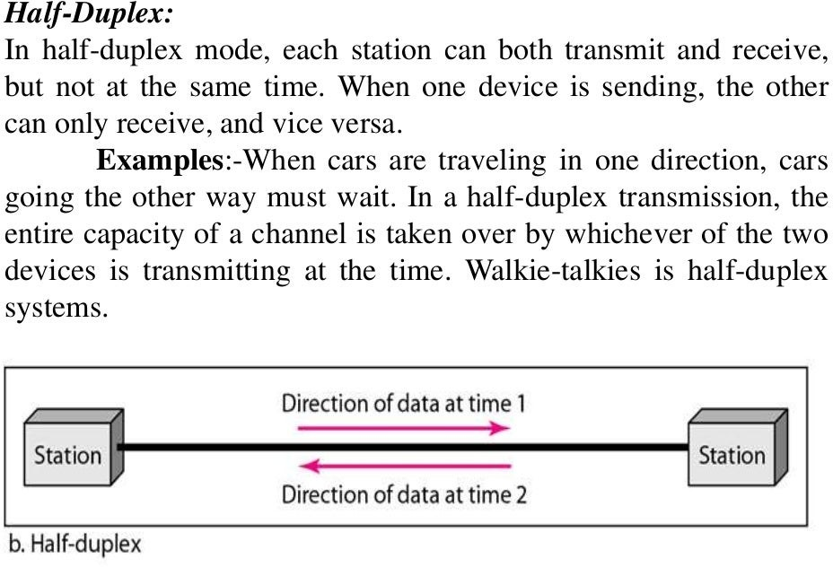

Slide 17
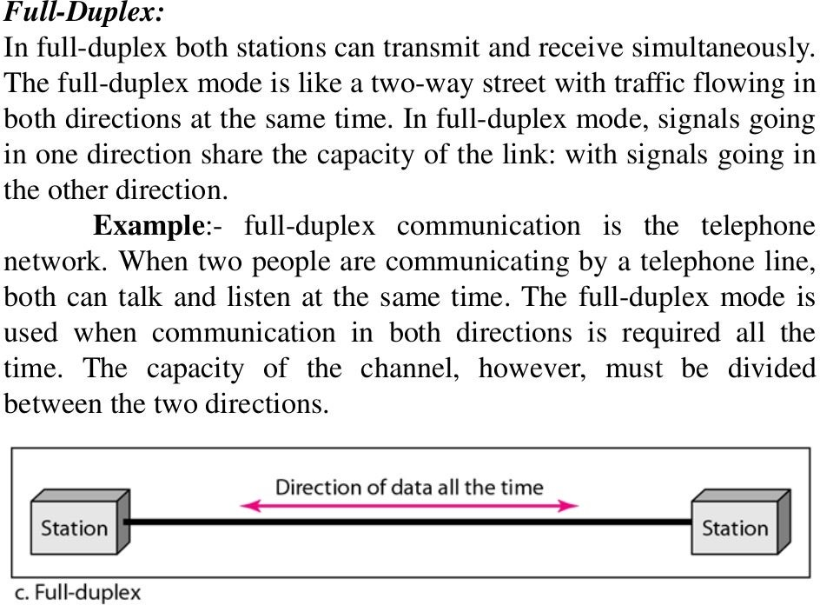

Slide 18
Definitions
A network is a set of devices (often referred to as nodes) connected by communication links.
A node can be a host (such as a computer, a laptop, a smart phone etc.) or a network device (such as a switch, a router, etc.).
A link is a communication pathway that transfer data from one device to another.

Slide 19
Network Criteria
A network must be able to meet a certain number of criteria.
Performance
Reliability
Security

Slide 20
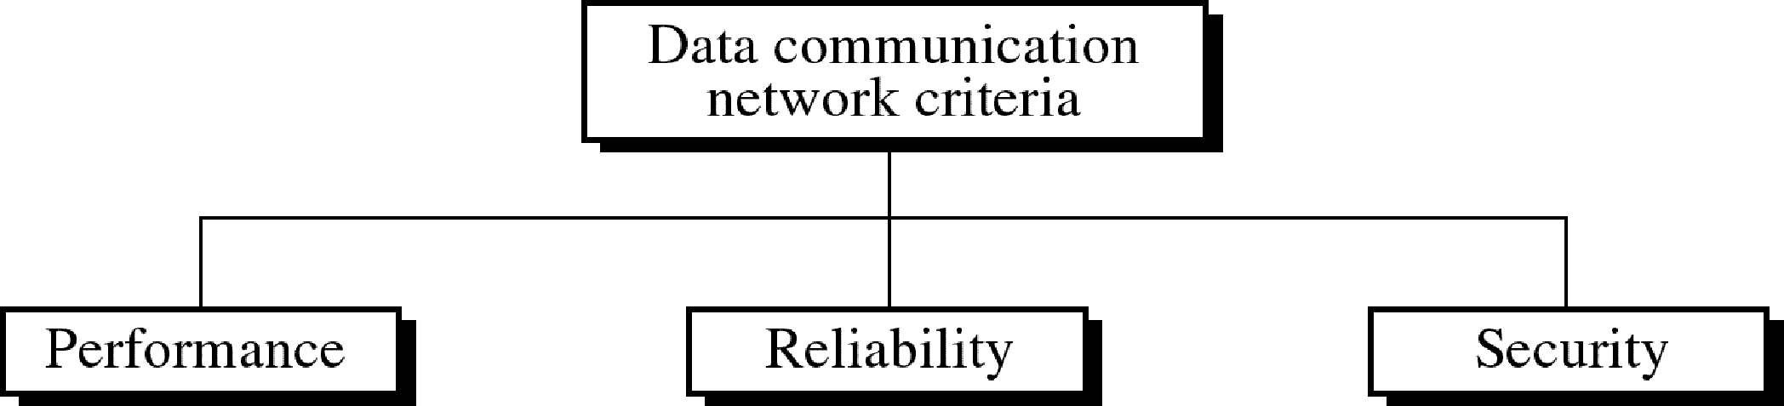
Figure 1-2
WCB/McGraw-Hill
© The McGraw-Hill Companies, Inc., 1998

Slide 21
Performance
Can be measured in many ways!
Transmit time: the amount of time required for a message to travel from one device to another.
Response time: the elapsed time between an inquiry and a response.
Often evaluated by two networking metrics: throughput and delay.

Slide 22
Throughput
Throughput is an important network metric which is also known as bandwidth.
The bandwidth of a network is given by the number of bits that can be transmitted over the network in a certain period of time.
Depends on the network technology (hardware capabilities) and therefore is constant.

Slide 23
Throughput Example
A network might have a bandwidth of 10 million bits/second (Mbps), meaning that it is able to deliver 10 million bits every second.

Slide 24
Delay
Also known as latency.
corresponds to how long it takes a message to travel from one end of a network to the other.
Latency is measured strictly in terms of time.
Effected by number of users and hence may change from time to time.

Slide 25
Delay Example
A transcontinental network might have a latency of 24 milliseconds (ms); that is, it takes a message 24 ms to travel from one end of North America to the other.

Slide 26
Factors Affecting Performance
Type of transmission media,
Capabilities of connected H.W and the efficiency of software.
Number of user

Slide 27
Network Criteria
A network must be able to meet a certain number of criteria.
Performance
Reliability
Security

Slide 28
Reliability
Accuracy of delivery.
Measured by:
Frequency of failures
Time it takes to recover from a failure
The network’s robustness in a catastrophe.

Slide 29
Network Criteria
A network must be able to meet a certain number of criteria.
Performance
Reliability
Security

Slide 30
Security
Many issues at the different layers!
Examples:
Protecting data from unauthorized access.
Protecting data from damage.
Implementing policies and procedures for recovery from breaches and data losses.

Slide 31
Network Configuration
There are a number of ways that computers can be connected together to form networks.
Physical attributes of a network include:
Type of connection
Physical topology

Slide 32
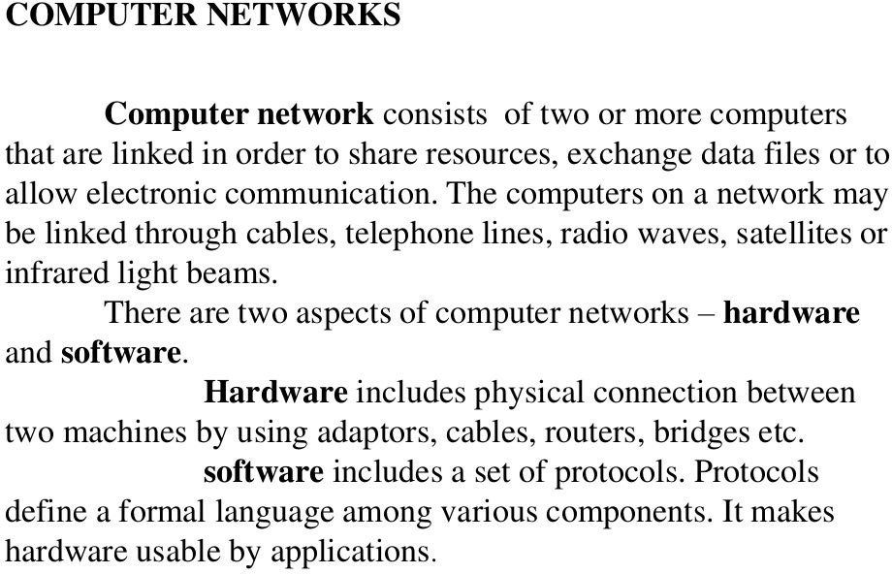

Slide 33
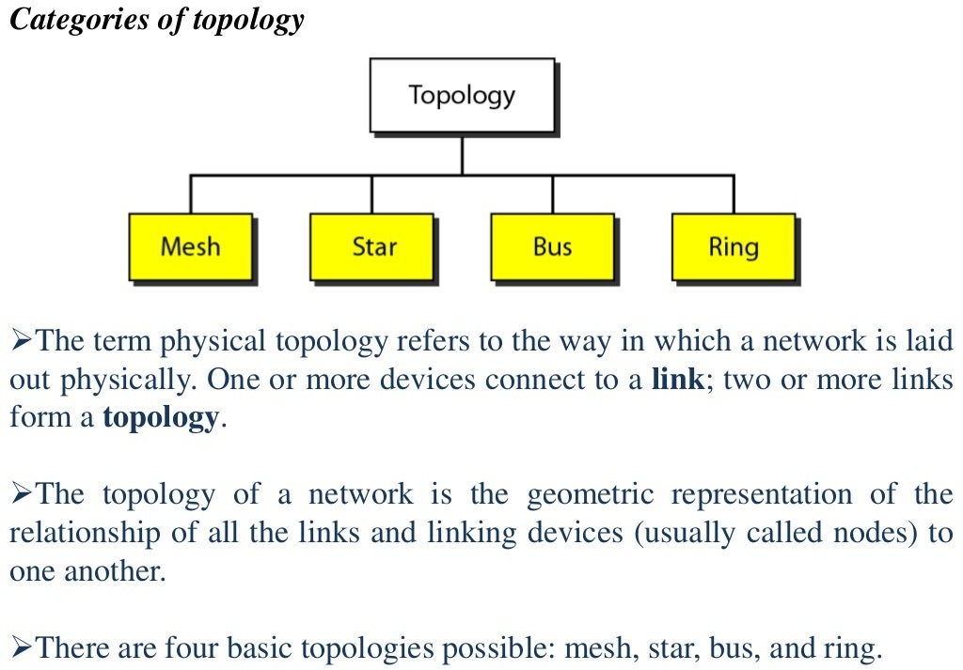

Slide 34
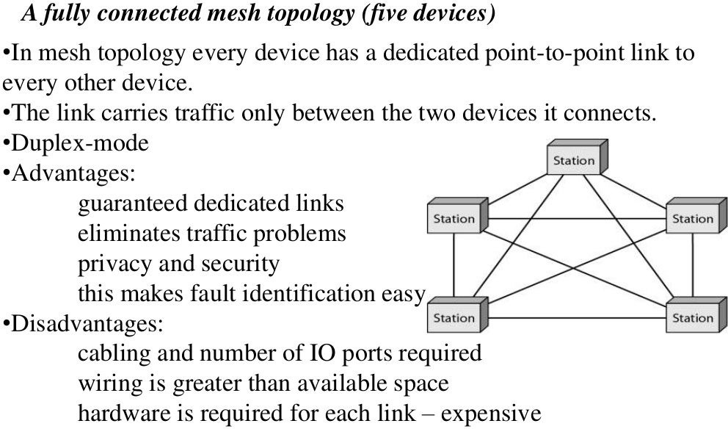

Slide 35
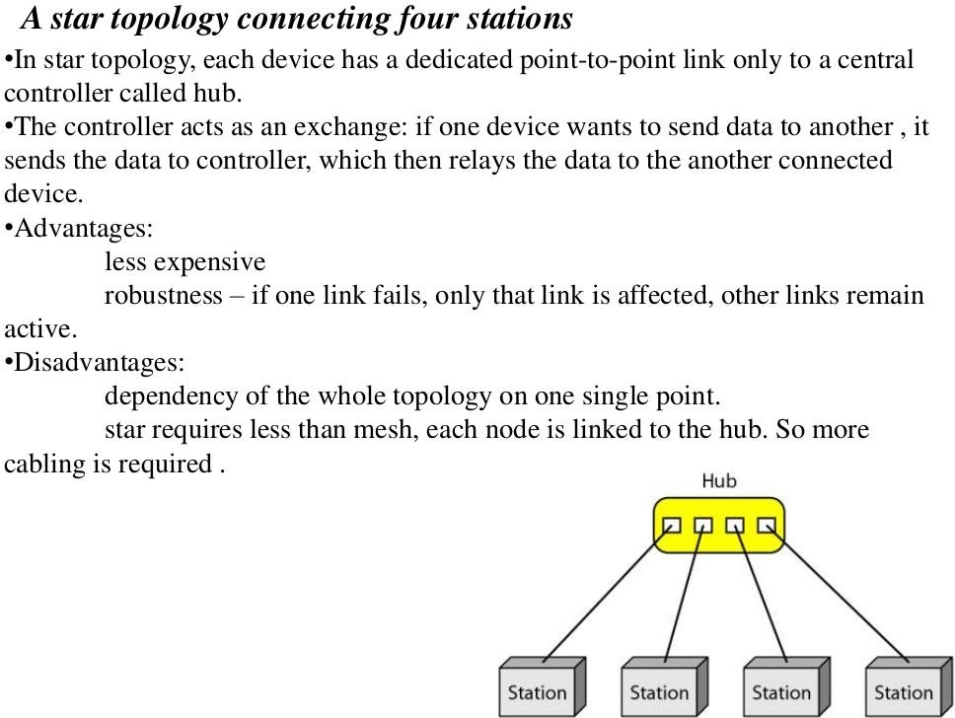

Slide 36
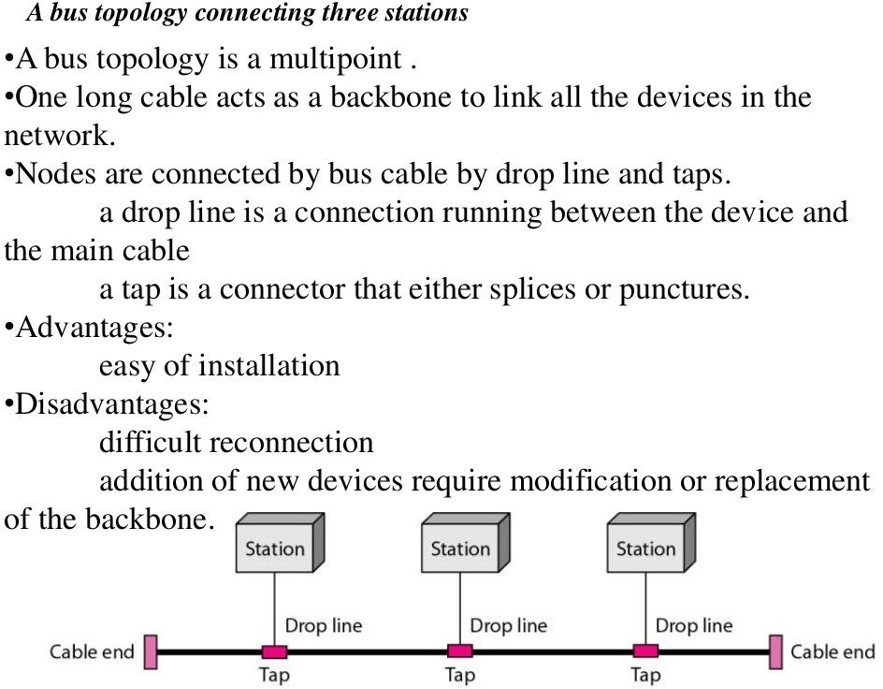

Slide 37
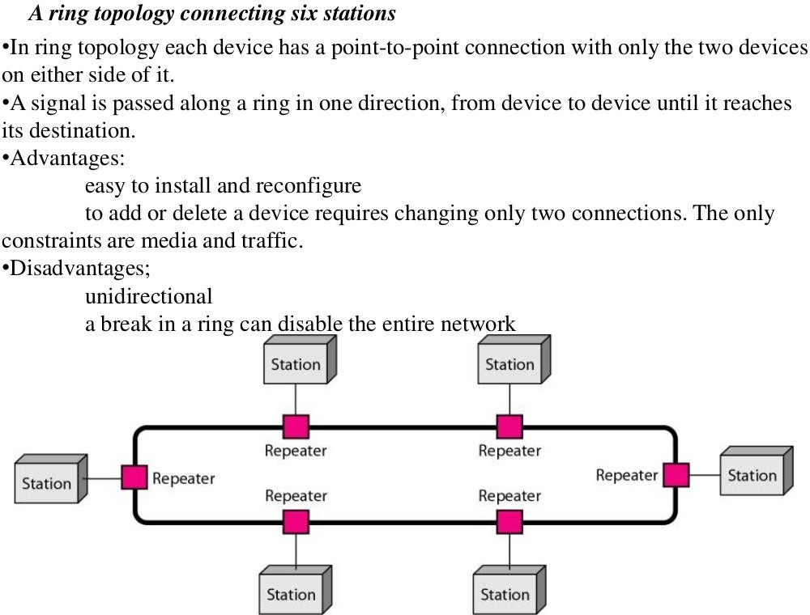

Slide 38
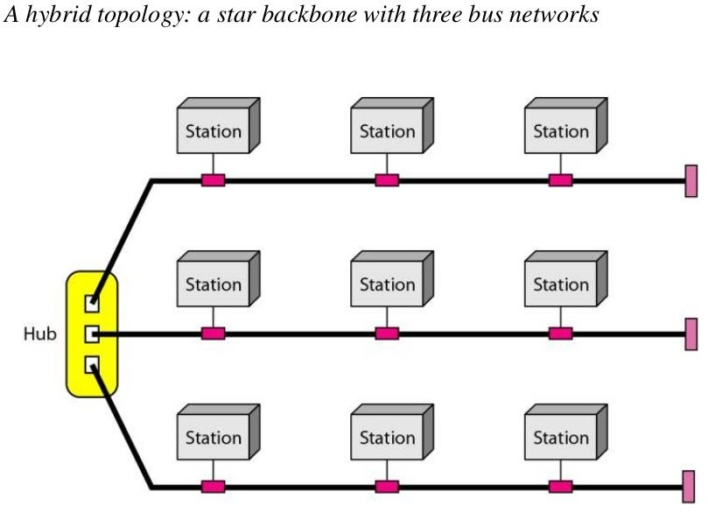

Slide 39
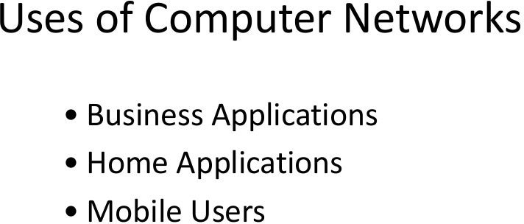

Slide 40
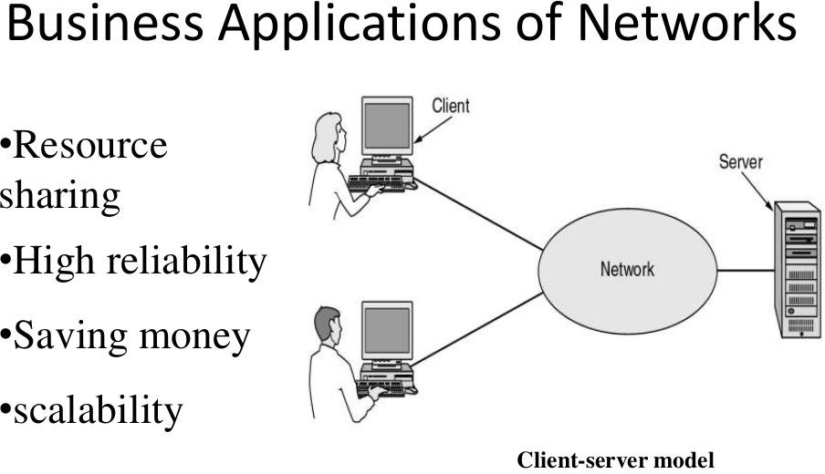

Slide 41
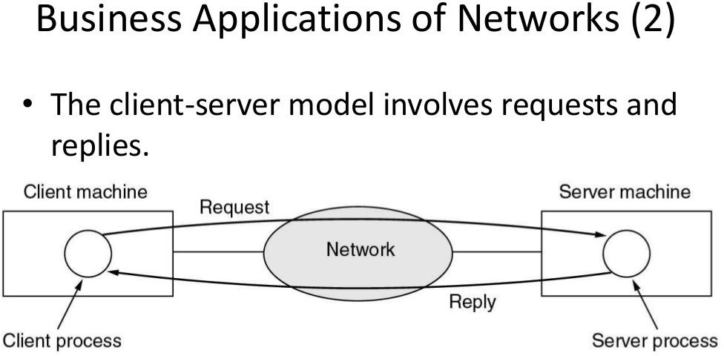

Slide 42
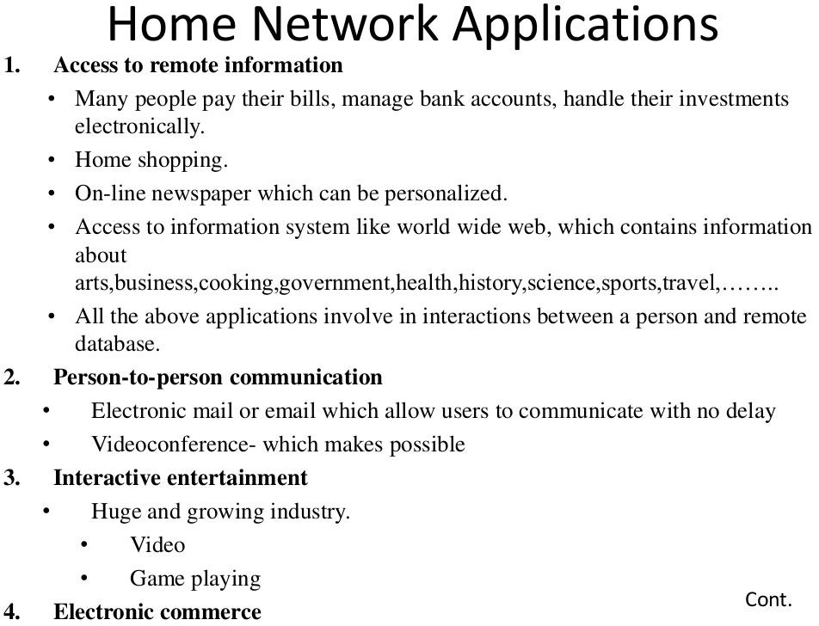

Slide 43
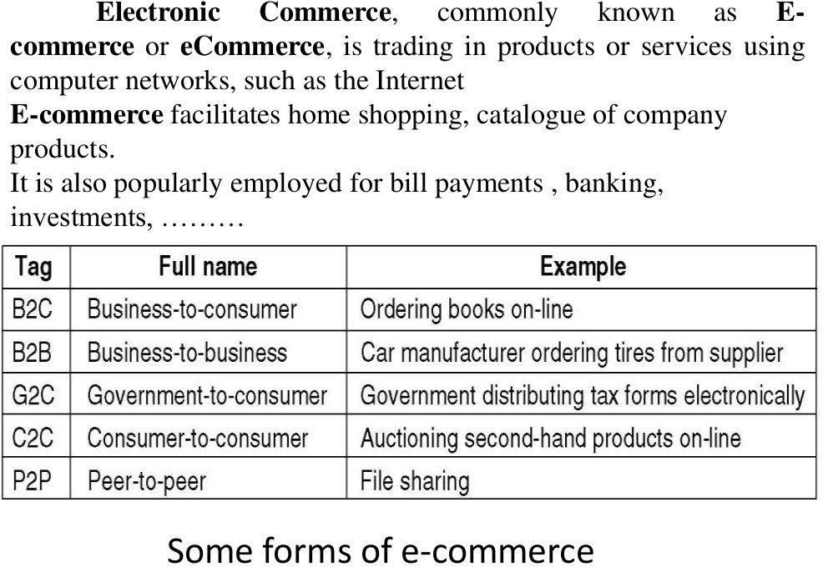

Slide 44
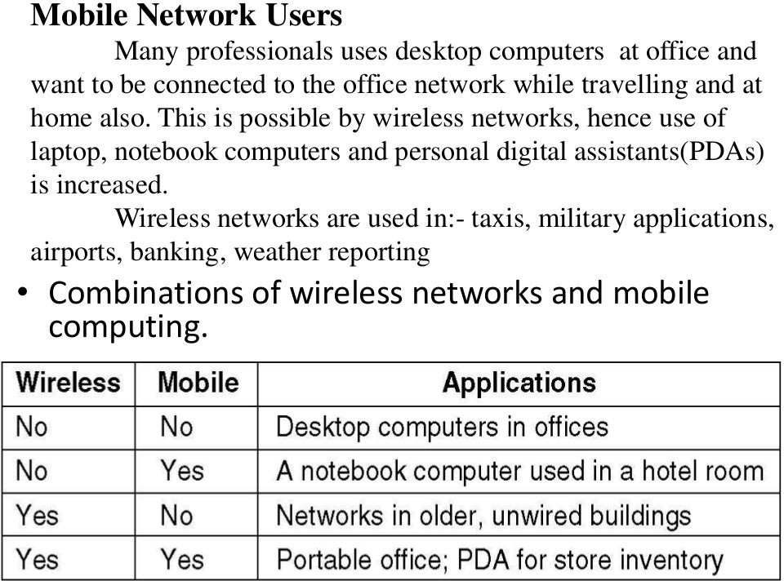

Slide 45
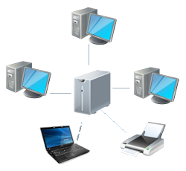
What is a Computer Network?
A set of computers which are connected together.
This can mean two computers cabled together on the same desk, or thousands of computers across the world.
The connections can be cables or wireless.

Slide 46
Advantages of Computer Networks
Enables users to share hardware like scanners and printers. This reduces costs by reducing the number of hardware items bought.
Allows users access to data stored on others' computers. This keeps everyone up-to-date on the latest data
Can share access to the Internet.

Slide 47
Advantages of Computer Networks
Can even let users run programs that are not installed on their own computers but are installed elsewhere in the network.
reduces the effort for networks administrators to keep programs configured correctly and saves a lot of storage space.

Slide 48
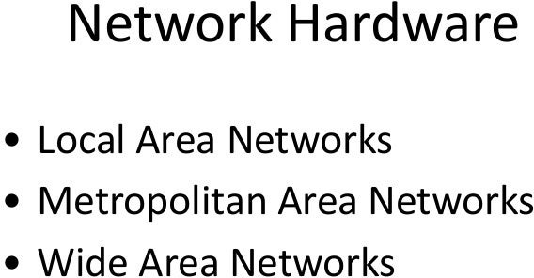

Slide 49
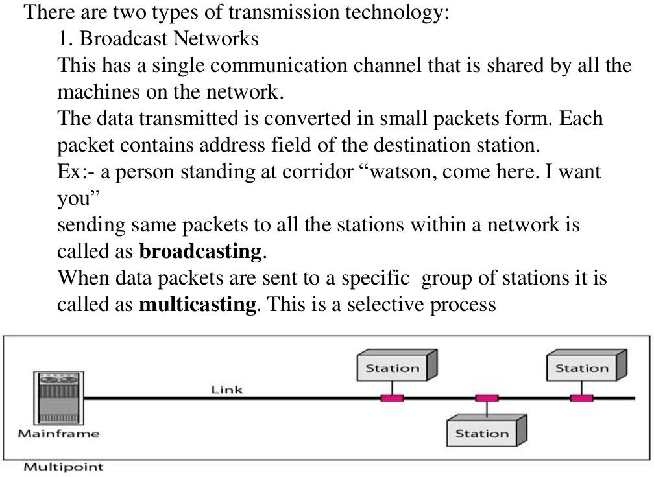

Slide 50
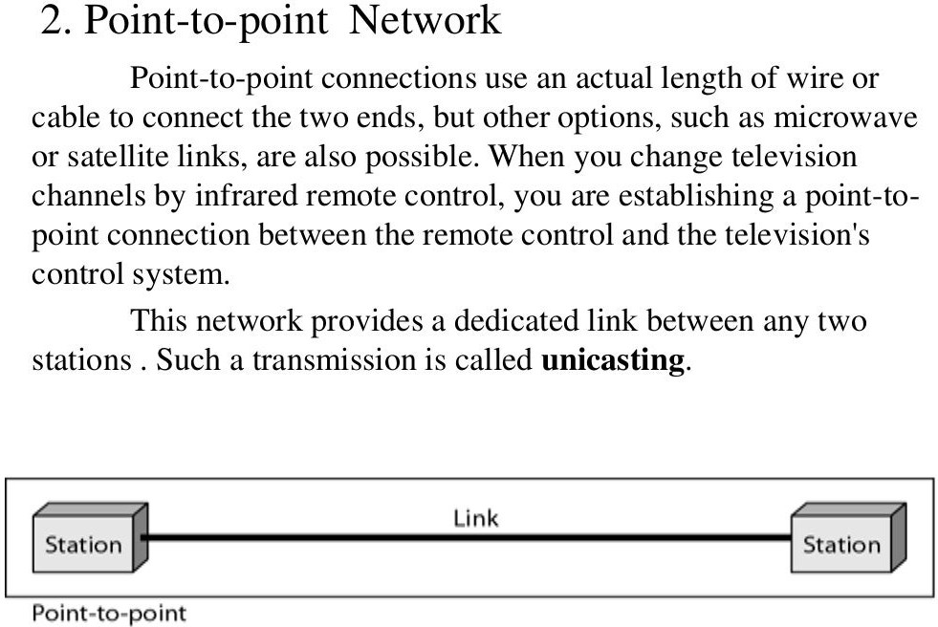

Slide 51
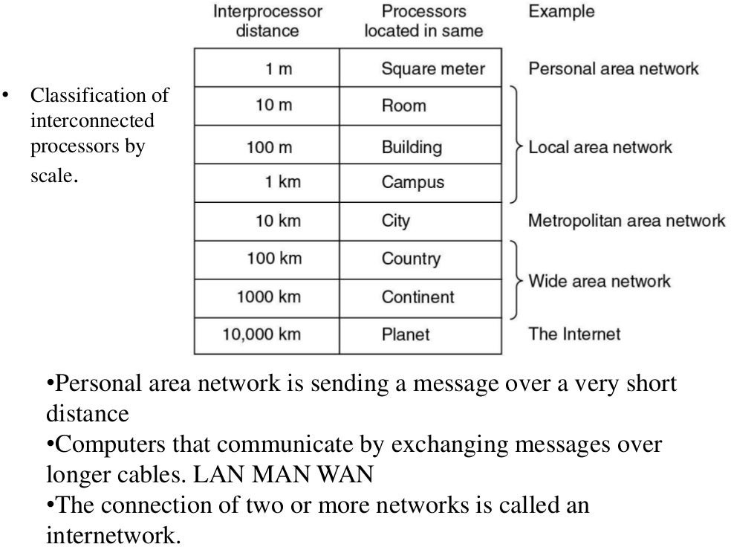

Slide 52
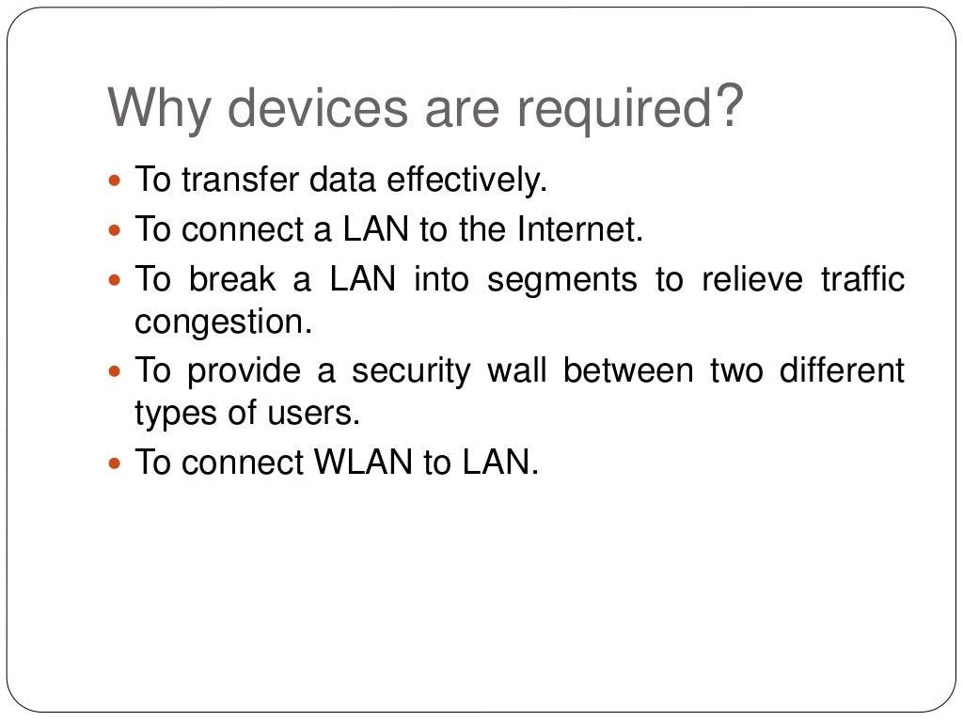

Slide 53
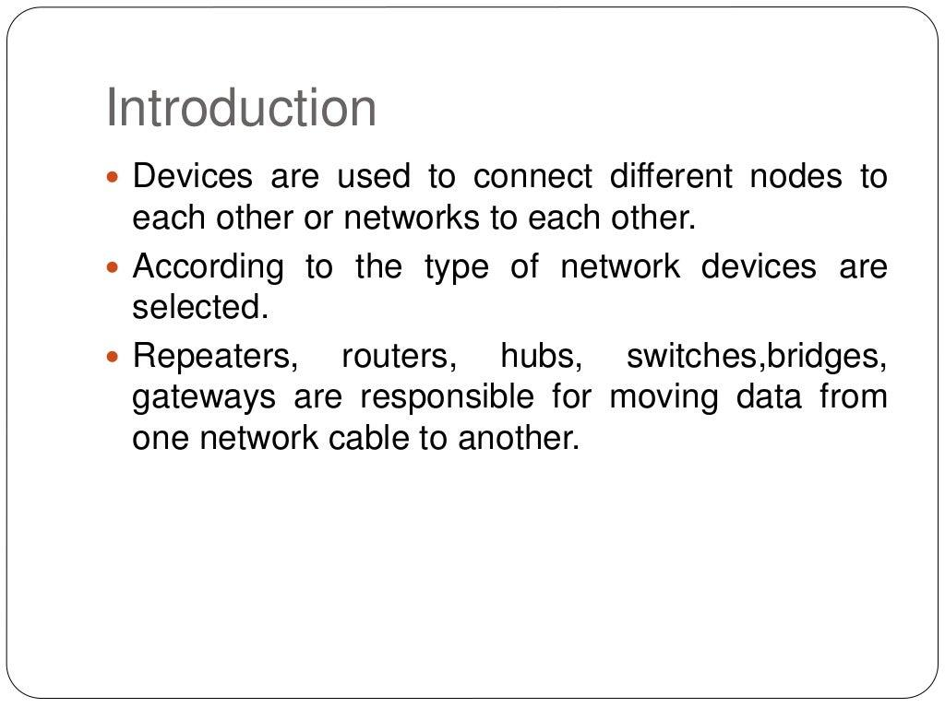

Slide 54
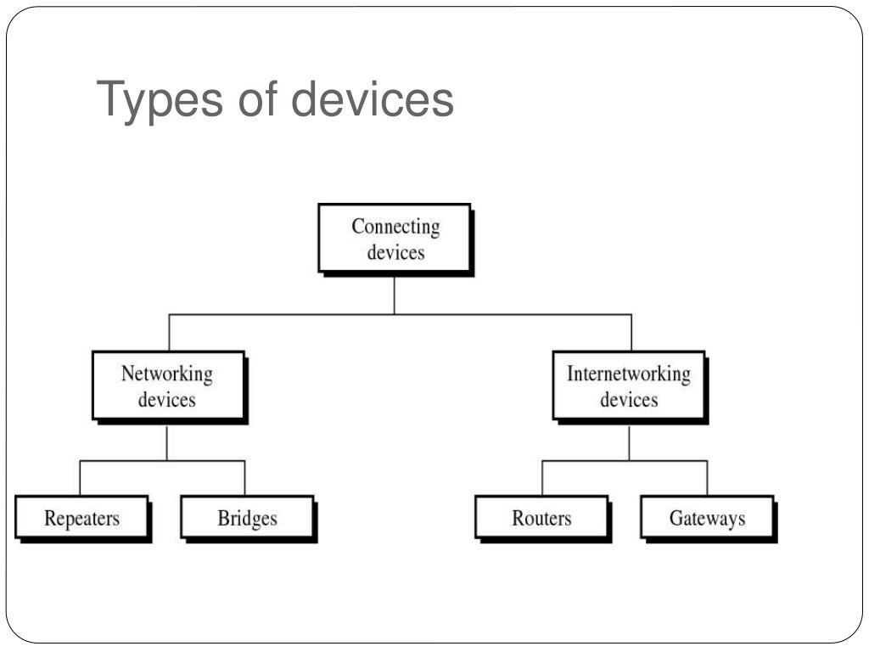

Slide 55
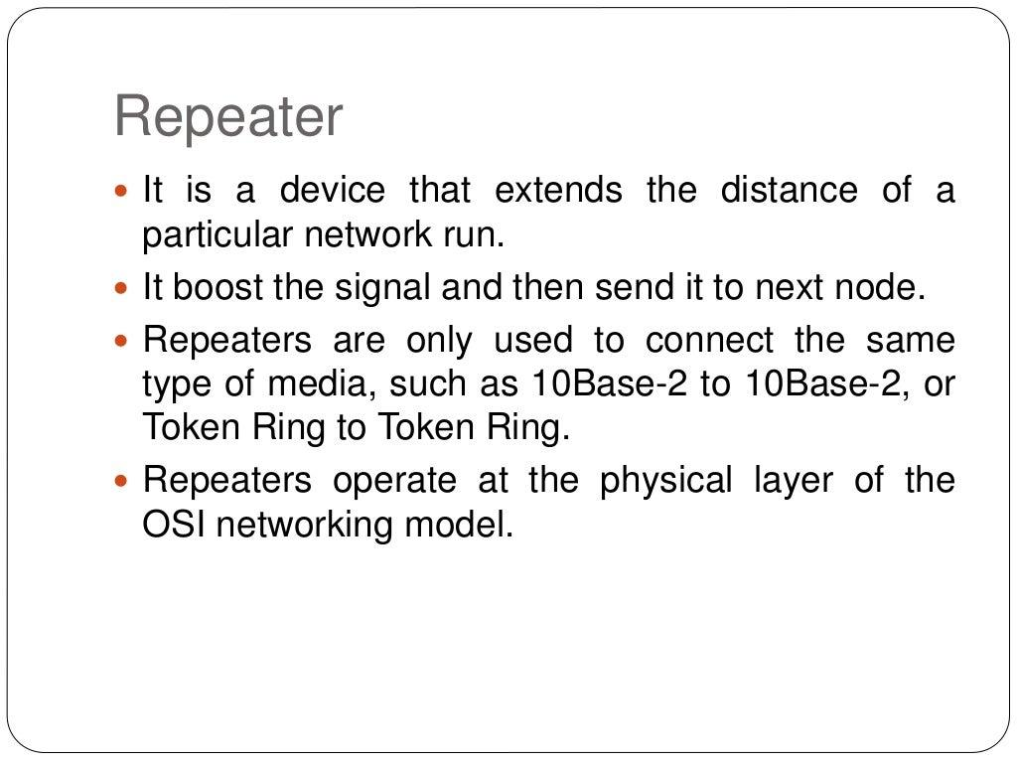

Slide 56
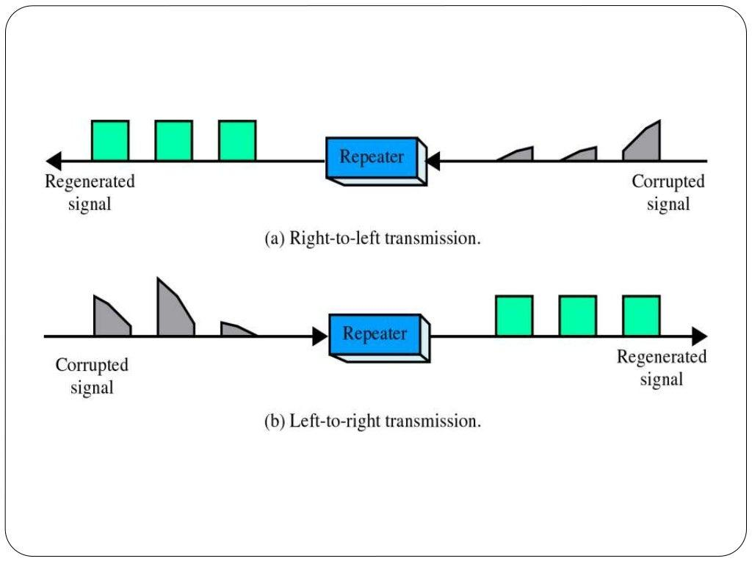

Slide 57
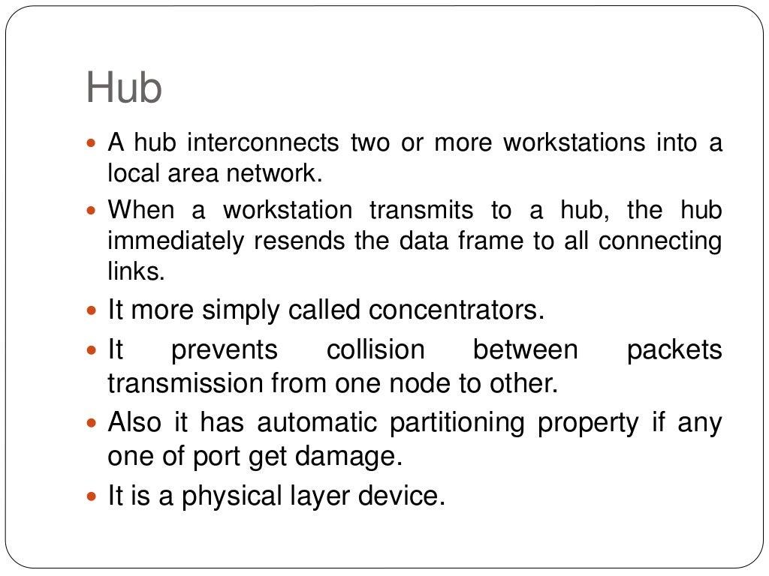

Slide 58
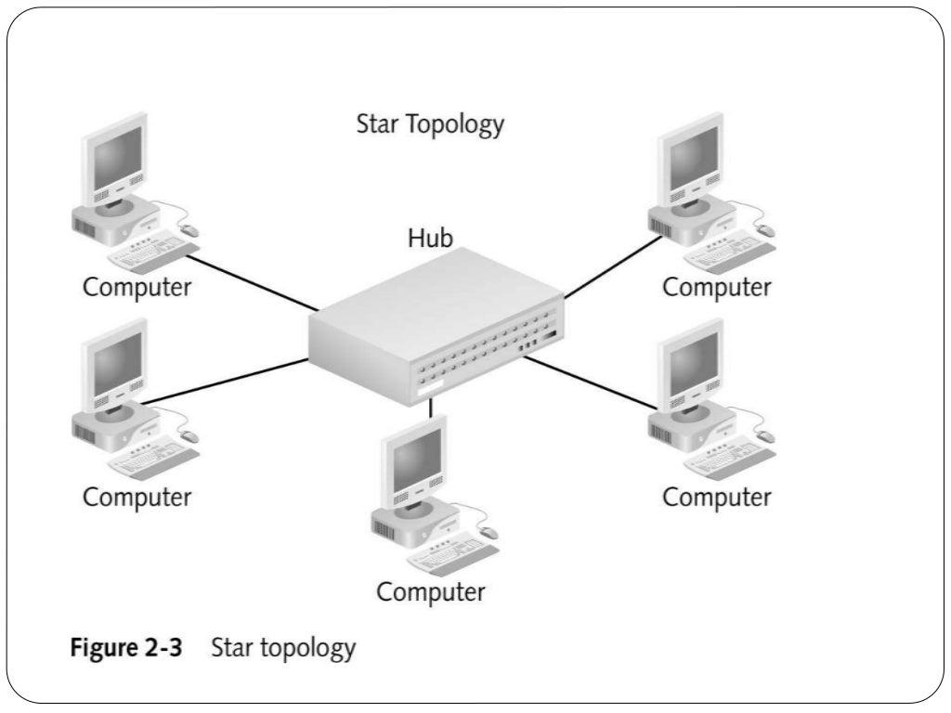

Slide 59
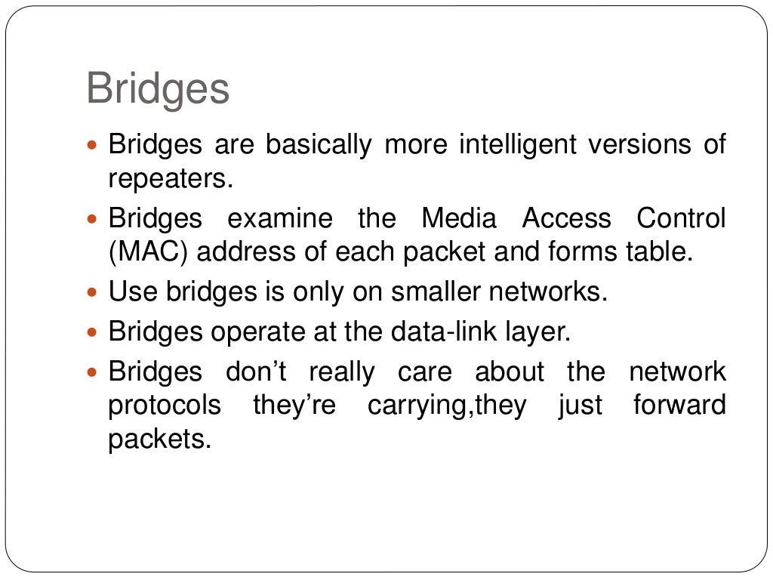

Slide 60
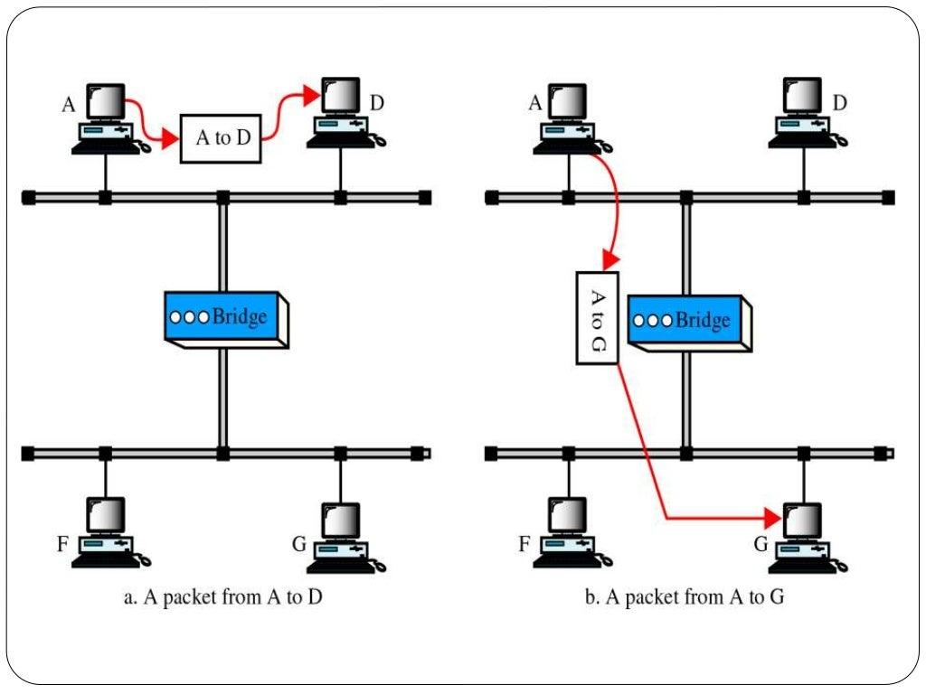

Slide 61
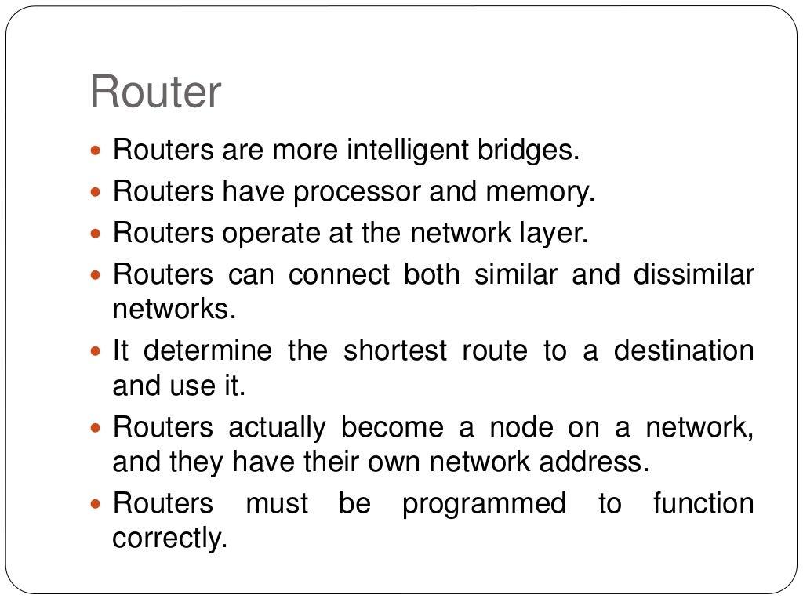

Slide 62
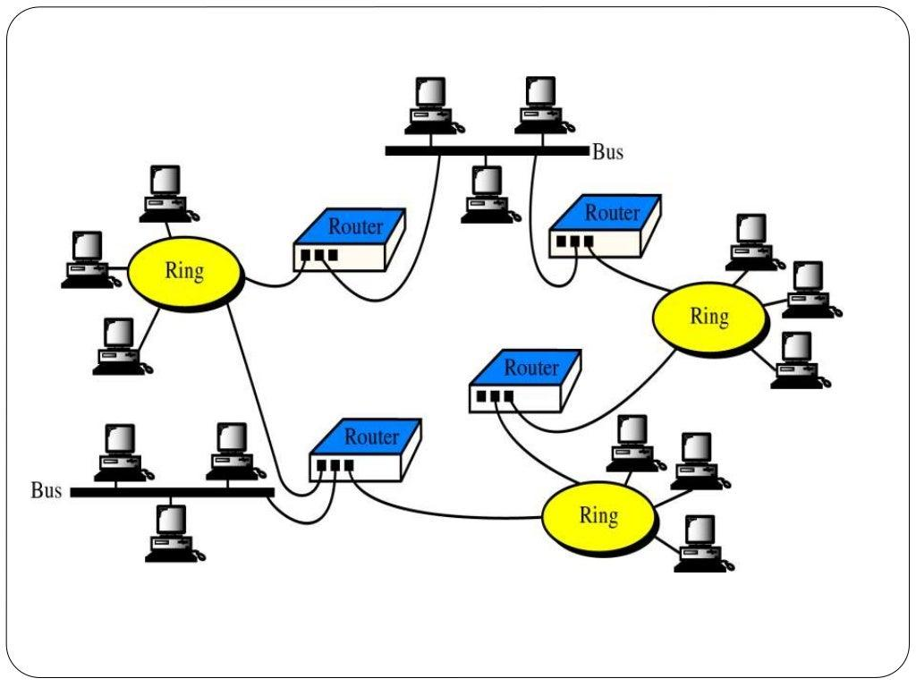

Slide 63
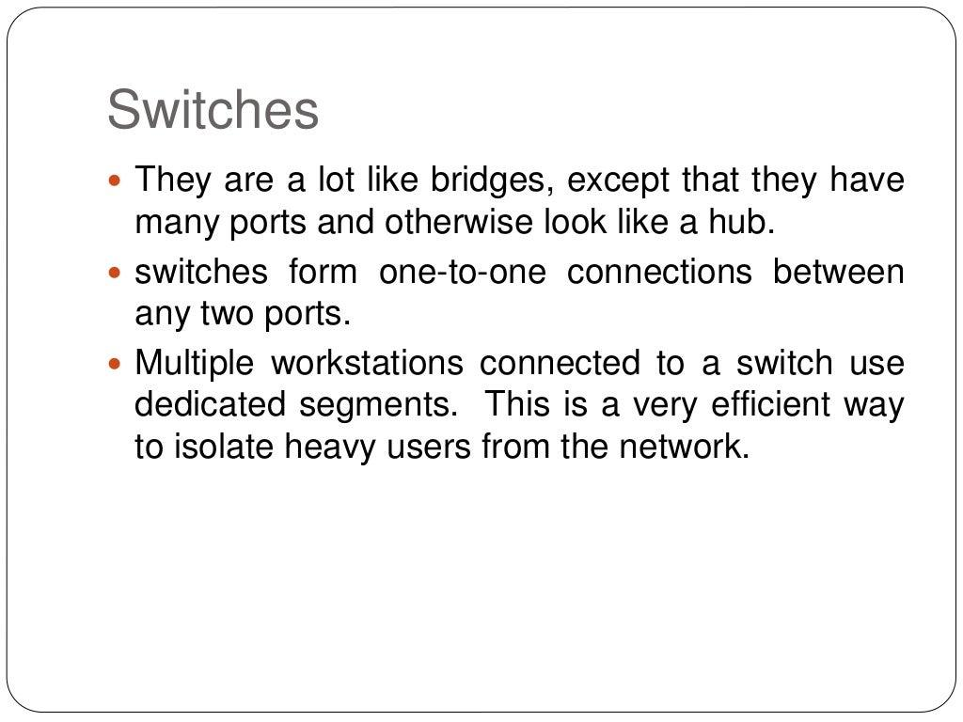

Slide 64
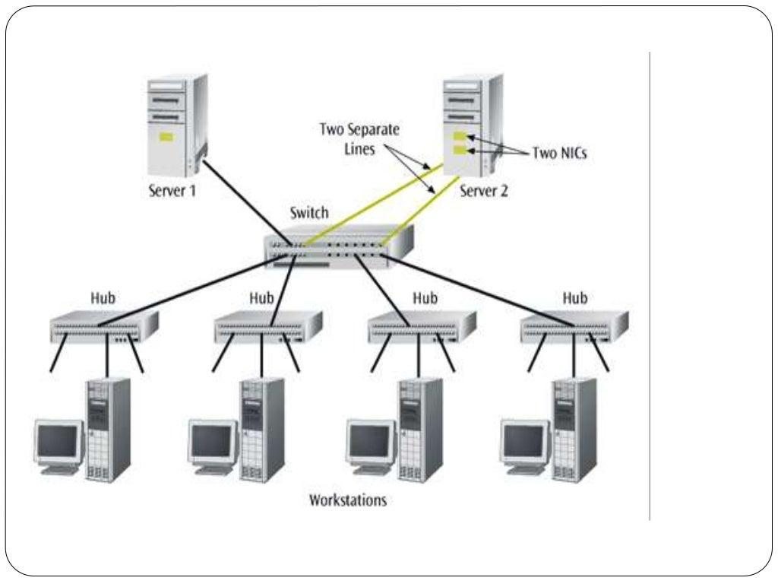

Slide 65
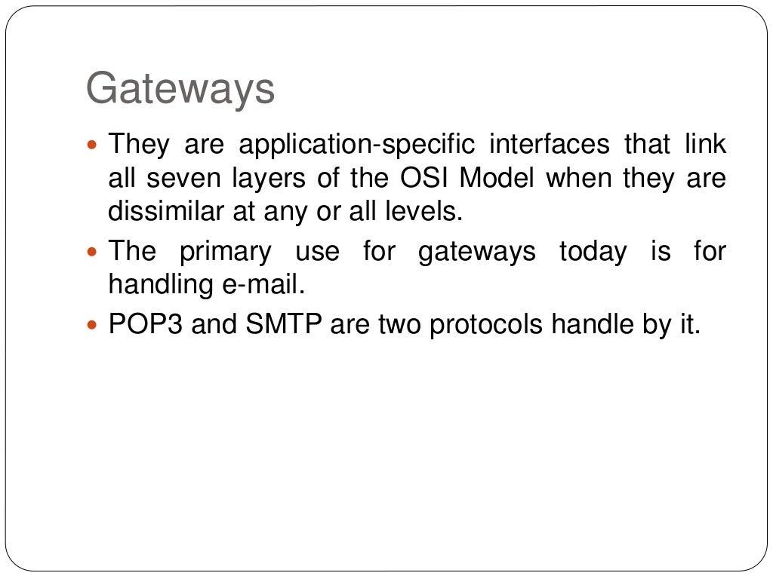

Slide 66
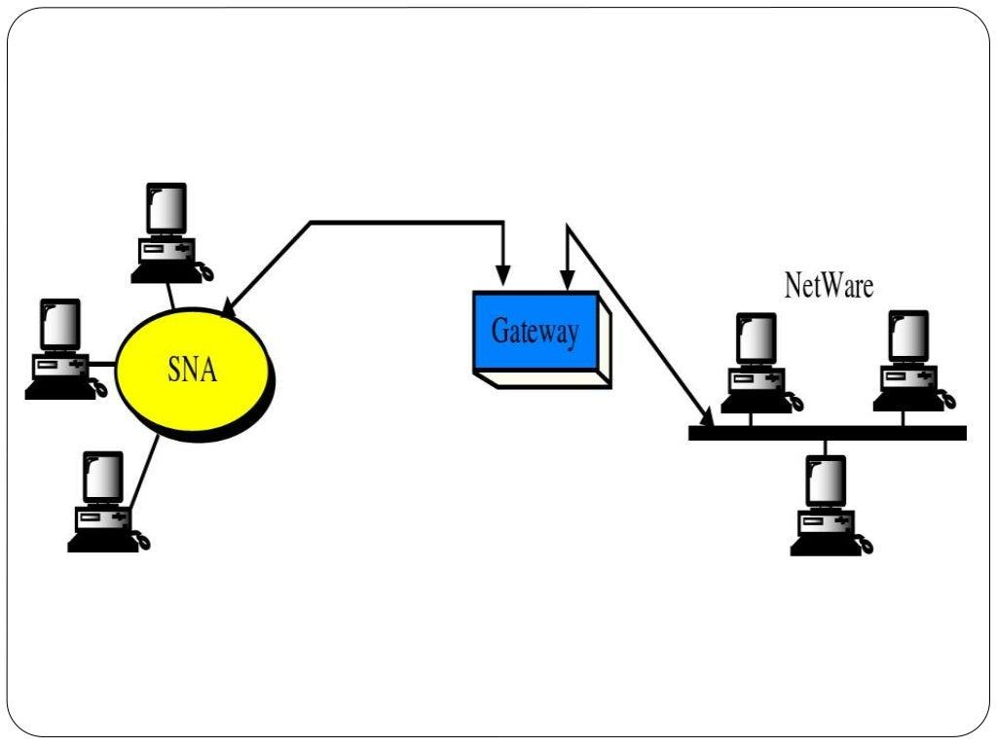

Slide 67
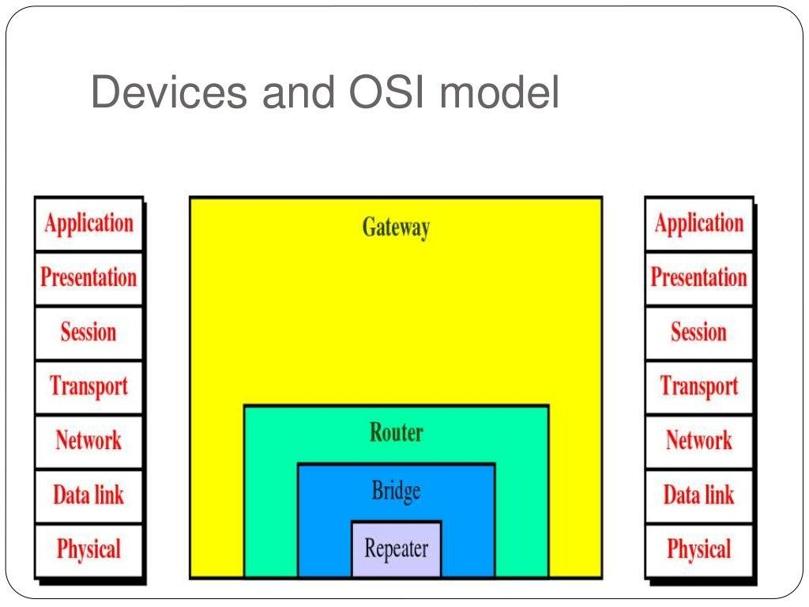

Slide 68


Slide 69


Slide 70


Slide 71


Slide 72


Slide 73


Slide 74


Slide 75


Slide 76


Slide 77


Slide 78


Slide 79


Slide 80
Interconnection of Networks: Internetwork
An internet (small i) is two or more networks that can communicate with each other.

Slide 81

Internetworking
To interconnect two or more networks, one needs a gateway or router.
Host-to-host connectivity is only possible if there’s a uniform addressing scheme and a routing mechanism.
Messages can be sent to a single destination (unicast), to multiple destinations (multicast), or to all possible destinations (broadcast).

Slide 82


Slide 83


Slide 84


Slide 85


Slide 86


Slide 87


Slide 88


Slide 89


Slide 90


Slide 91


Slide 92


Slide 93


Slide 94


Slide 95


Slide 96


Slide 97


Slide 98


Slide 99


Slide 100


Slide 101


Slide 102


Slide 103


Slide 104


Slide 105


Slide 106


Slide 107


Slide 108


Slide 109


Slide 110


Slide 111


Slide 112


Slide 113


Slide 114


Slide 115


Slide 116


Slide 117


Slide 118


Slide 119


Slide 120


Slide 121


Slide 122


Slide 123


Slide 124


Slide 125


Slide 126


Slide 127


Slide 128


Slide 129


Slide 130


Slide 131


Slide 132


Slide 133


Slide 134


Slide 135


Slide 136


Slide 137


Slide 138


Slide 139


Slide 140


Slide 141


Slide 142


Slide 143


Slide 144


Slide 145


Slide 146


Slide 147


Slide 148


Slide 149


Slide 150


Slide 151


Slide 152


Slide 153


Slide 154


Slide 155


Slide 156


Slide 157


Slide 158


Slide 159


Slide 160


Slide 161


Slide 162


Slide 163


Slide 164


Slide 165


Slide 166


Slide 167


Slide 168


